Slide 1

Exploring US Census Data (ACS) with Interactive Map and Charts: Determining where to live in current state of economy
Hamere Mogus, Spencer R Weed, and Jamilet Cordon

Slide 2
Thought Process
The motivation and importance behind developing the web app
Identify key factors influencing decisions
Utilize The American Community Survey (ACS) from the U.S census Bureau
Use the “tidycensus” package to access the ACS data.
Gather information at state level
Enhance user engagement/interactivity
Use “leaflet” and “shiny” packages to build an interactive map/web.
Understand socio-economic trends
Help individuals make informed decisions
Income + Cost of living
Age + Population
Other Visualization techniques

Slide 3
Introduction
Objective:
Our web app aims to provide platform using census data to explore various regions and assess their economic landscape, enabling users to make informed decisions about where to live.
Approach:
Our approach involves integrating census data through comprehensive analysis and visualization techniques, including maps, charts ,and filters.

Slide 4
What can you do with our app?
Interactive Map:
Interactive Charts:
Dive deeper into the data with interactive charts that allow you to compare different variables. Gap between Cost of living and Median earnings. Predictive models for each key indicator that forecast values up to year 2027.
Interactive Features:
Visualize key demographic and economic indicators such as median age, cost of living, and median earnings for each US state. Darker shades indicate higher value whereas lighter shades represent lower value
Features such as dropdown menus, toggles, and sliders.

Slide 5
How to get started
Navigate
Use the sidebar menu to explore different sections of the app, including interactive maps and charts.
Explore
Click on the state on the map or interact with the charts to see detailed information and trends.
Use the dropdown menu and filters to customize your exploration.

Slide 6
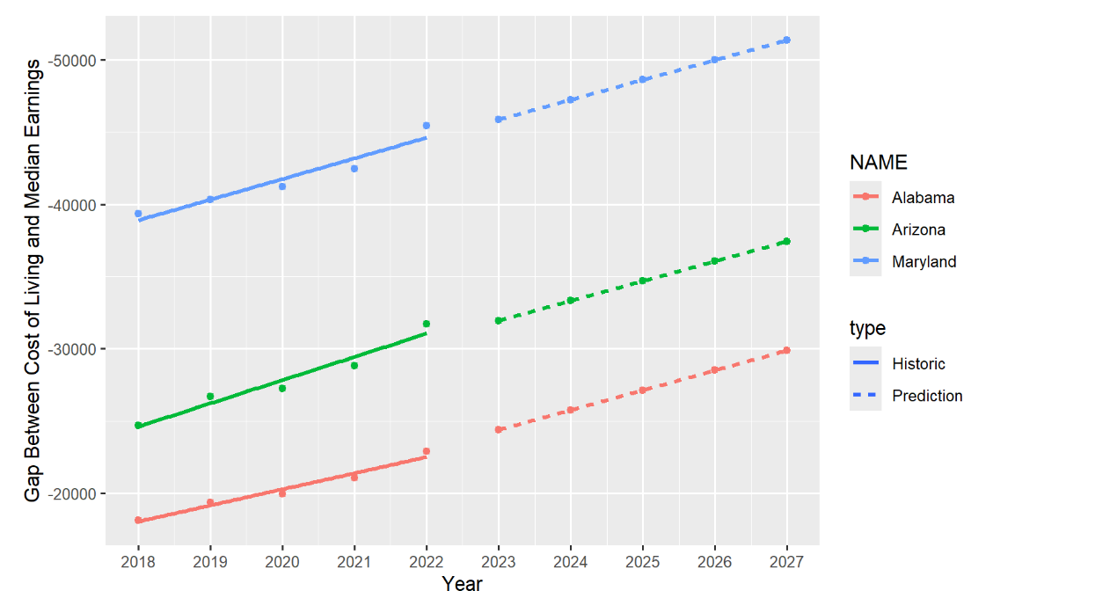
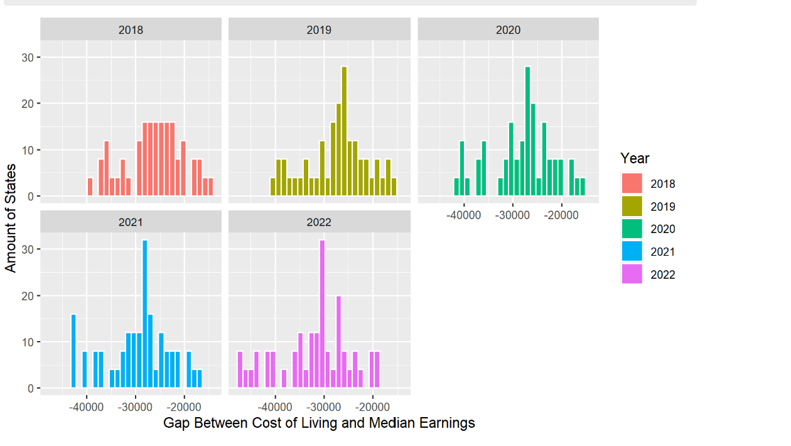
Findings and models

Slide 7
Challenges and Solutions
Challenge: Data Accuracy
Solution: Validate data integrity, and we verified our ID variables.
Challenge: user interface complexity
Solution: we designed the dashboard with user friendly interface that is easy to navigate.
shiny dashboard, drop down menus, descriptive labels
Challenge: performance optimization
Solution: We optimized data loading and filtering.
We minimized the UI elements.
We optimized deployment environment to improve performance.

Slide 8
Conclusion
Our web application offers valuable resources for individuals looking to make a move based on Socio-economic factors.
By incorporating the key factors discussed above, we encourage users to make informed decisions.

Slide 9
Demo
https://devfiregrasp.shinyapps.io/FinalProject/

Slide 10

Questions

